Slide 1
Dixson Ch. 6
The Oestrus That Never Was

Slide 2
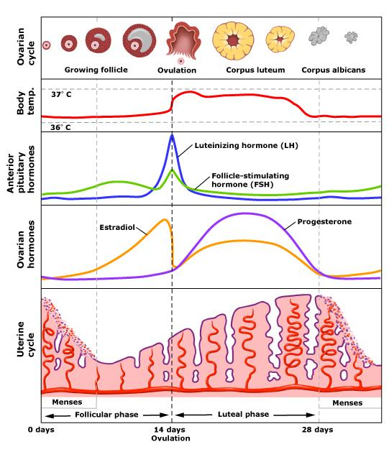
Human menstrual cycle

Slide 3
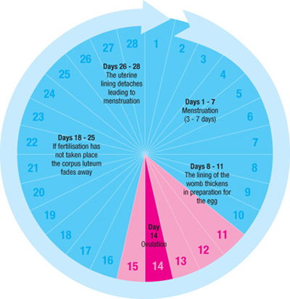

Slide 4
Oestrus vs. concealed ovulation
Two questions:
Does the species have oestrus or not?
Does the species have external physical signs of ovulation?

Slide 5
Oestrus
Oestrus is defined as the ovarian hormonal control of female sexual behavior, such that female receptivity (and therefore copulations) are restricted to a very brief window around the time of ovulation, when conception is most likely to occur

Slide 6
Visible signs of ovulation
Some animals exhibit physical signs of ovulation, external cues
Example: sexual skin swellings which are dependent on oestrogen
May take several days or longer to reach full tumescence, then begins to break down as soon as ovulation has occurred
Not necessarily related to oestrus

Slide 7
For many years, and still today, people confuse “oestrus” with visible signs of ovulation
Old World Monkeys, Apes, and Humans – Anthropoids – have menstrual cycles, but they do not have oestrus
Some have obvious physical signs of ovulation
Some do not – some have concealed ovulation

Slide 8
Humans are not unique
Concealed ovulation is not unique to humans; many other anthropoids have concealed ovulation
Loss of oestrus is not unique to humans; none of the anthropoids have oestrus; only the prosimians (Strepsirhini) and tarsiers have true oestrus

Slide 9
Why do primates have sex when they do?
Three components
Female attractiveness to males
Female proceptivity – female initiation/solicitation of sex from male
Female receptivity – female willingness to accept male advances

Slide 10
Female attractiveness
Affected by ovarian hormones
Leads to increased sexual activity during follicular phase and mid-cycle
Includes male attention to female sexual swellings, if present, as well as the smell of her vagina
When the female is “attractive” to the male, he will pursue her more assertively for mating

Slide 11
Female proceptivity
Female initiates sexual activity
May move in front of male and present rump
May make eye contact as a way to elicit male attention – “eye-contact proceptivity”
A result of neuroendrocine mechanisms different from those that govern receptivity

Slide 12
Female receptivity
Willingness of female to allow male to mount her and have sex
In primates (and other mammals) who have oestrus, this is a tightly circumscribed period of time, right around the time of ovulation, during which the females will allow the male to have sex (and at other times she will not allow the male to have sex with her)

Slide 13
“The propensity for females monkeys and apes (and humans) to display sexual receptivity at times other than when ovulation is likely is widespread . . .”
“Mutual attractiveness is an important determinant of copulatory frequency”
When able, females often decline male attempts to mate

Slide 14
“. . . cyclical changes in the effects of ovarian hormones upon the brain and sexual behavior certainly occur in anthropoids, but they are subtle, situation dependent, and more influenced by variations in mutual attractiveness between the sexes than is the case for many mammals. Hence the term “oestrus” is no more appropriate when applied to descriptions of sexual behavior in female monkeys or apes, than it would be in descriptions of human sexuality.”

Slide 15
Results of removal of ovaries
Common marmoset – females remain sexually receptive and sexually proceptive after removal of ovaries and adrenal glands

Slide 16
Conclusions
“A relaxation of rigid hormonal control of female sexual behaviour is a trait shared by the anthropoids in general.”
“Loss of oestrus is an ancient phenomenon.”
“The evolution of sexual skin swellings in the chimpanzees and bonobos may have occurred after the common ancestors of these apes diverged from the line which ultimately gave rise to Homo.”
“Sexual skin swellings have arisen and have been lost a number of times during anthropoid evolution.”

Slide 17
Evidence that anthropoid primates do not have oestrus
Extended time when female is receptive, throughout cycle, even though frequency is higher in follicular phase and at mid-cycle
Removal of ovaries does not affect receptivity

Slide 18
Difference between proceptivity and receptivity
Mary Small & sense of hunger – she no longer gets hungry (pro.), but is almost always willing to eat (rec.)
Kathy Dettwyler & sense of thirst – she lost her sense of thirst (pro.) to chemotherapy for cancer, but is almost always willing to drink (rec.) (as long as the liquid is not plain water, which makes her gag, a not-uncommon side effect of chemotherapy)

Slide 19
Lovejoy, et al.
Claimed that “loss of oestrus”
Is unique to humans
Evolved after hominid line split from other Great Apes
Translates into “females are always willing to have sex”
Claimed that “concealed ovulation”
Is unique to humans
Contributed to evolution of pair-bonding in humans
Males had to “mate guard” all the time to ensure paternity
Males got more sex in exchange for provisioning of female and offspring

Slide 20
Fisher, Burley
Helen Fisher argued that the unique loss of oestrus/concealed ovulation allowed women more opportunities for extra-pair copulations
Such confusion of paternity might then have protected offspring from infanticidal males
Nancy Burley argued that the same features, unique to human females, made it more difficult for women to avoid conception because they themselves didn’t know when they were ovulating

Slide 21
Mittelschmerz
Mittelschmerz (German: "middle pain") is a medical term for "ovulation pain" or "midcycle pain". About 20% of women experience mittelschmerz, some every cycle, some intermittently.
Ovulation can also be detected through
Keeping track of basal body temperature (spikes at ovulation)
Keeping track of changes in various characteristics of cervical/vaginal mucous

Slide 22
Natural Family Planning
http://www.ccli.org/
The Couple to Couple League
Use of long-term breastfeeding, tracking of ovulation through various techniques, and abstinence when ovulating to space children without the use of contraceptives

Slide 23
Human menstrual cycle & sexual behavior
Handout on comparison of EEA vs. modern Western women’s experience of menstruation
Menstrual cycles relatively rare for most of human evolution, prehistory, history, and still in much of the world today, due to:
Later menarche (mean = 15 years)
Early first pregnancy
Long periods of lactational amenorrhea
Many subsequent cycles of preg./lact amen.
Earlier menopause (mean = 45 years)

Slide 24
Modern women, sexual frequency, & stage of menstrual cycle
Study Figure 6.10
On average, about 28% of women having sex on any given day
Sex more frequent in follicular phase of cycle, peaking on day before ovulation, then falling off rapidly
Very similar to pattern seen in other primates, including those who have obvious external signs of ovulation
Wilcox et al. (2004) also found that women tend to have sex more on the weekends

Slide 25
A few other studies have suggested more proceptive behavior in women on days right around ovulation
Some evidence that, during the most fertile part of her cycle (peri-ovulation) women prefer:
More masculine faces (rated as more sexy/attractive)
The smell of men who are more symmetrical
Taller men
Men who are socially dominant or competitive

Slide 26
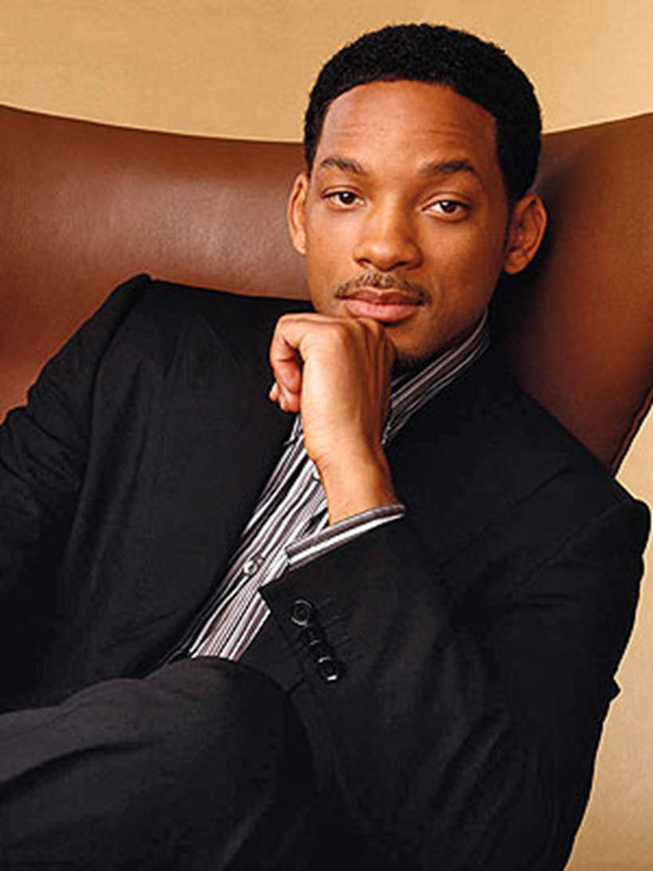

Slide 28
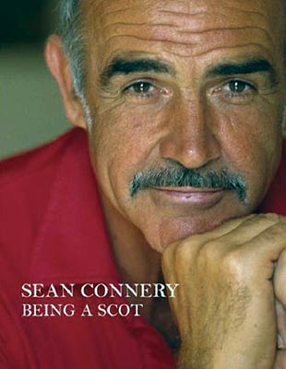
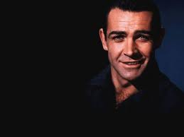

Slide 29
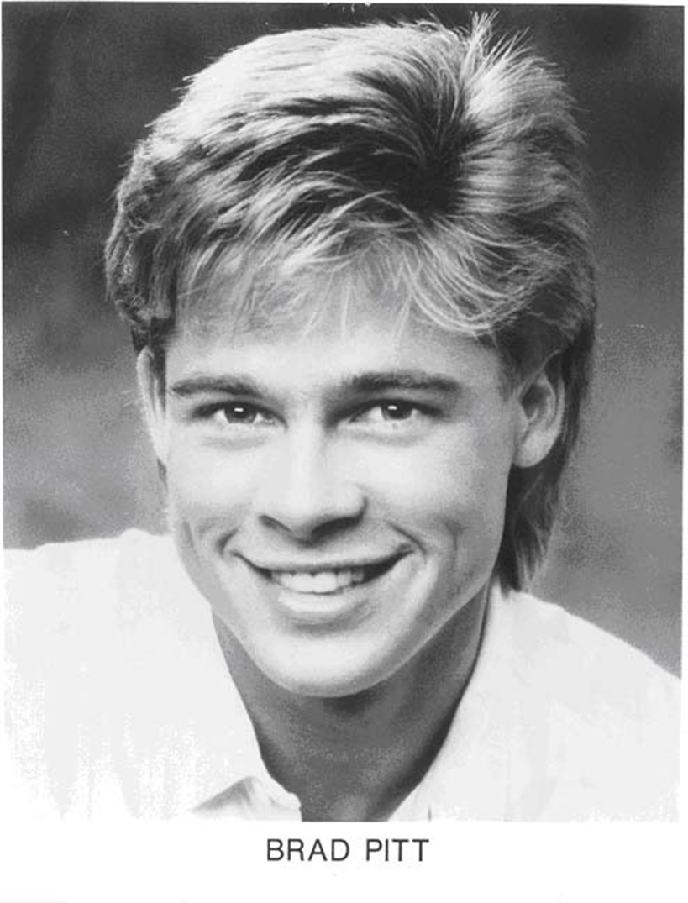

Slide 30
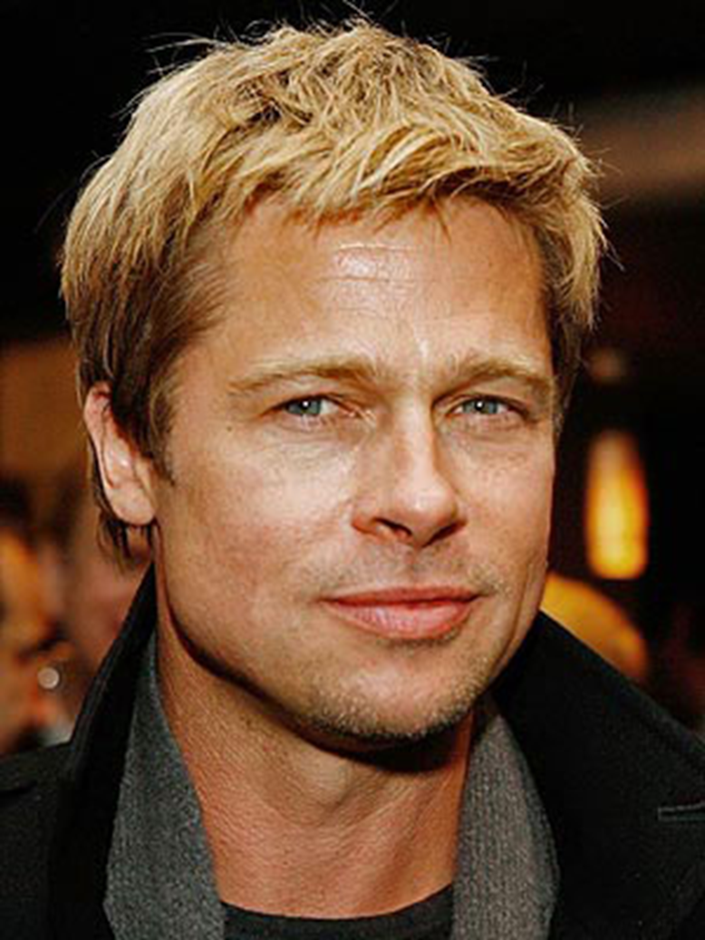

Slide 31
Is George Clooney the new Cary Grant?

Slide 32
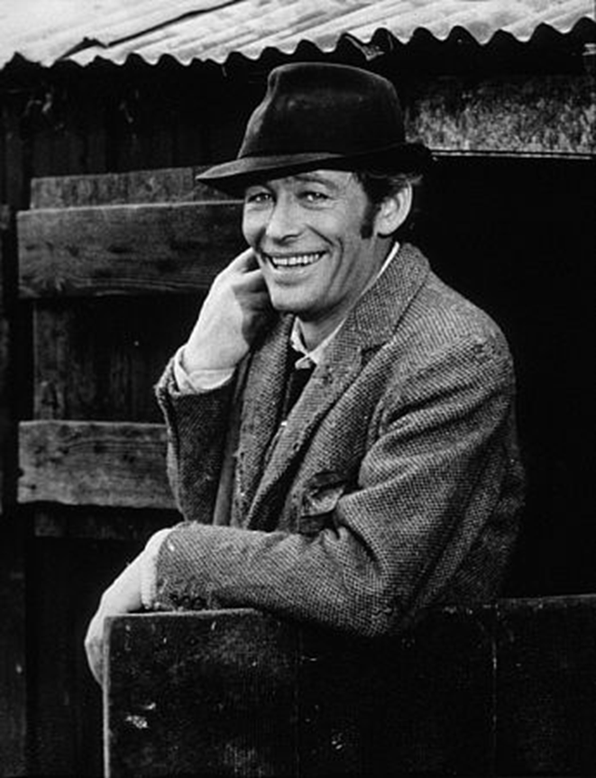

Slide 33
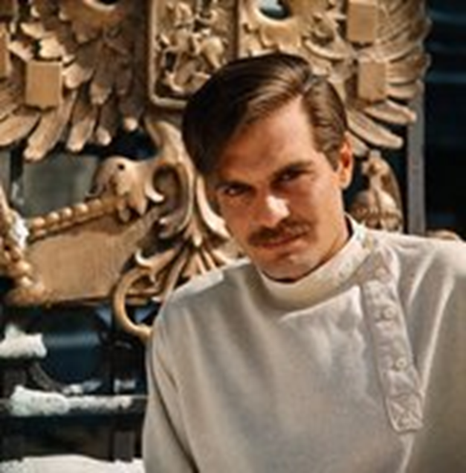

Slide 34
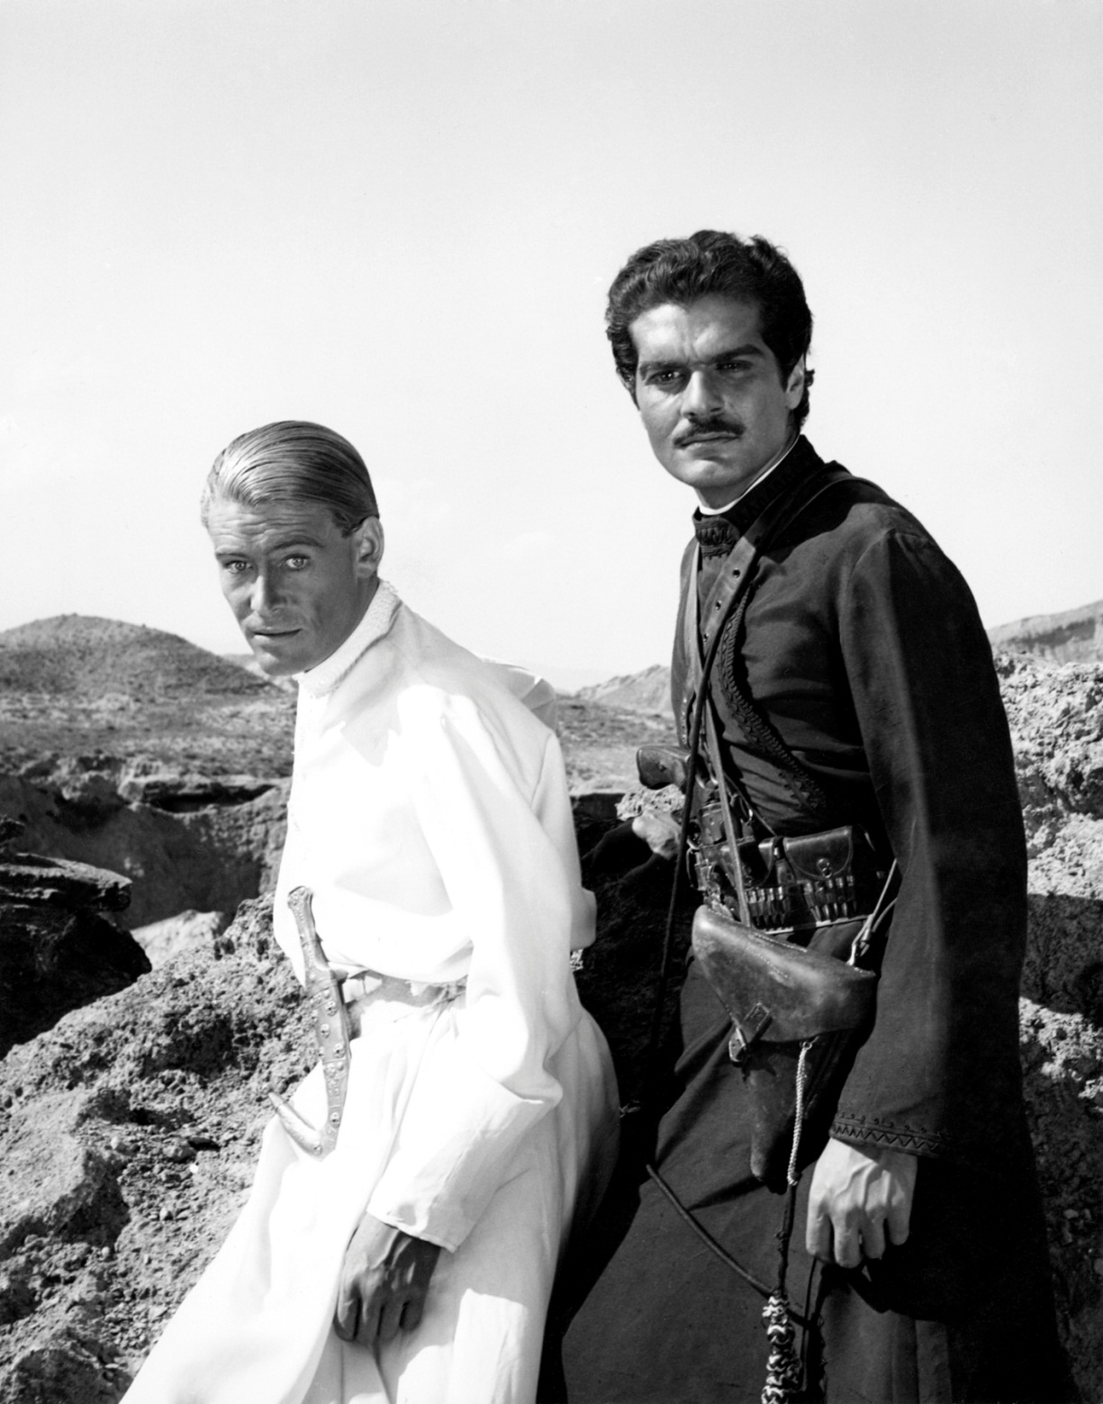
Together in “Lawrence of Arabia”

Slide 35
Dual-Mating Strategies
These data have been used to support the idea that women pursue dual-mating strategies – looking for different sets of traits depending on whether they are looking for a long-term relationship, a pleasant companion, a good provider, or a short-term relationship that will provide “good genes” for their offspring
Symmetry, height, and more masculine faces = good genes

Slide 36
Assumptions about female choice
All these theories are assuming that women are:
Free to choose who they wish to marry and who they wish to have short-term relationships with
That they are able to attract the object of their desire (that the feelings are mutual)

Slide 37
Dixson is skeptical . . .
Of the dual-mating strategy hypothesis, b/c
He thinks that shifts in preferences of women during different stages of their cycles are not large or meaningful, and the research is done under artificial conditions
He points out that humans tend to form long-term partnerships for mating and raising children, and
That marriage is almost universal among human cultures
That “romantic love is a universal human attribute”

Slide 38
Dettwyler’s concerns
I agree with Dixson that the dual-mating strategy argument is not well-supported by the evidence
I agree that almost every human culture has marriage, and that romantic love is a universal human attribute
I agree that having adult males contribute to the care and provisioning of children aids in the survival of said offspring
However . . .

Slide 39
In many cultures that have romantic love, it is not necessarily the basis for marriage, and is not necessarily linked to sexual behavior
A woman (or a man) may very well fall in love with someone, but that doesn’t mean they can be married to that person (ex: Romeo & Juliet)
Romantic love can flourish between two people of opposite sex, or between two people of the same sex, and yet not involve any sexual behavior

Slide 40
Pre-eclampsia
Interesting data on pre-eclampsia, which suggests that women are better off if they stick with a long-term partner (and if they have been with him for some time before getting pregnant by him)
10% of human pregnancies are affected by severe hypertension, known as pre-eclampsia, due to immunological incompatibility between mother and fetus
Over time, a woman’s immune system becomes habituated to her partner’s seminal products, thus reducing the risk of pre-eclampsia

Slide 41
Conclusions
“Comparative studies indicate that a rigid neuroendocrine control of female receptivity and proceptivity during the peri-ovulatory period was lost in ancestral anthropoids. Thus, extant monkeys and apes, as well as women, lack oestrus, whilst it is still present among the prosimian primates.”
We don’t know why this loss of oestrus occurred, or why some anthropoids have concealed ovulation, but it isn’t to facilitate pair-bonding, or confuse paternity, or to reduce male infanticide in humans uniquely.

